Slide 1
Electric Vehicles
Capacitor Car Racing
STEMitUP
Co-funded by the ERASMUS + programme of the European Union

Slide 2
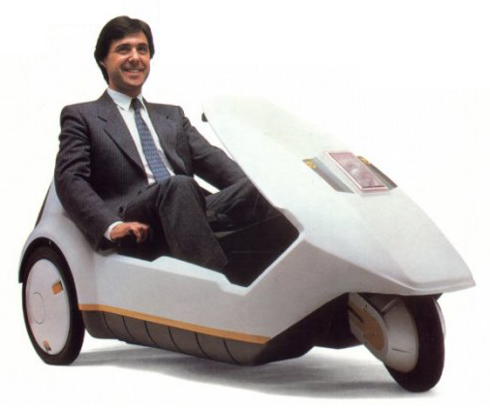
Sinclair C5:
Why
Why did it fail?
Notes:
Teacher notes: This electric vehicle was developed in the 1980s by Clive Sinclair (a successful personal computer entrepreneur) in the UK and was widely mocked. Major drawbacks included exposure to the weather, poor visibility (other motorists couldn’t see), difficult to drive (notice handles rather than steering wheel), need for pedals inside for extra power, a limited range and a fixed seat position.

Slide 3
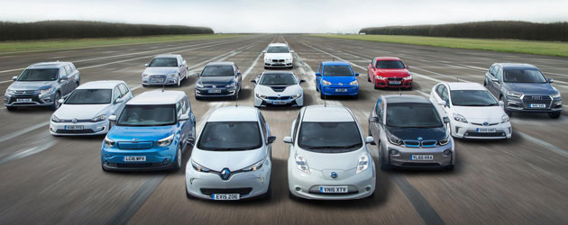
Electric Vehicles today
What makes these cars more likely to succeed?
Notes:
Teacher notes: Range, speed and recognisable/ proven “car” format.

Slide 4

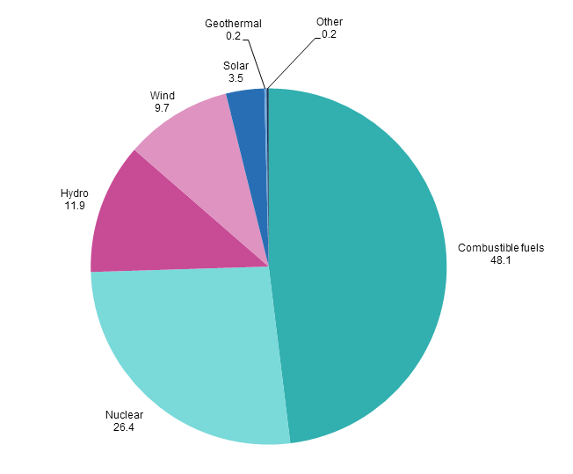
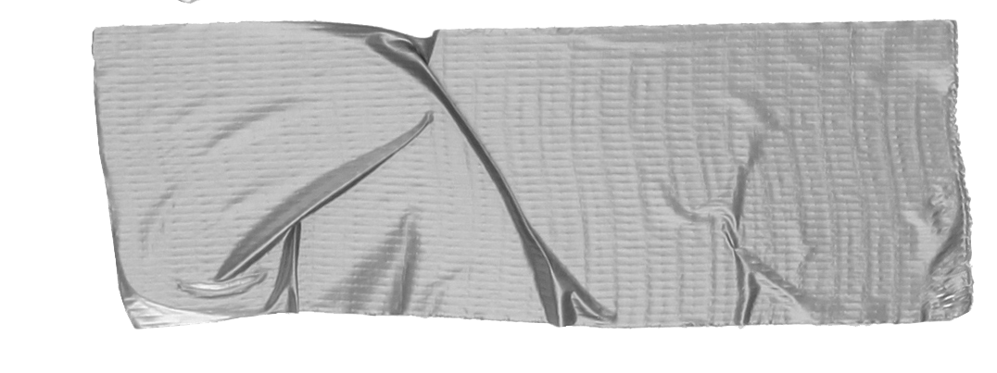

Generating Electricity in the EU
Did you know?
The UK is the windiest country in Europe making it ideal for wind farms.
Source: Eurostat (nrg_105a)
Notes:
OPTIONAL SLIDE: these 2015 data for the EU shows how electricity is being produced. This information could be used to extend the discussion into how we sources our energy and changes that are underway. Major changes over the past few years in the UK mean coal has gone from one of the most to one of the least significant sources with a greater fraction coming from gas and renewables with nuclear projected to make a greater contribution in the near future.

Slide 5
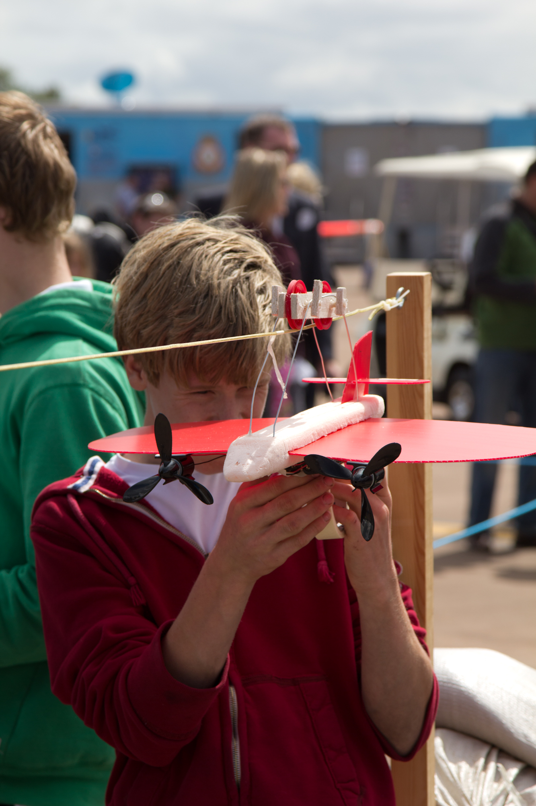
Your engineering challenge
Design and build a capacitor powered vehicle that will compete in two competitions:
Time Trial - a short sprint where top speed is important
Distance - which vehicle will go the furthest?

Slide 6
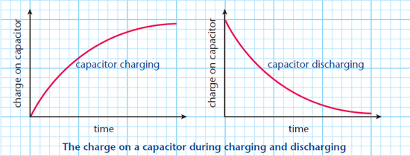
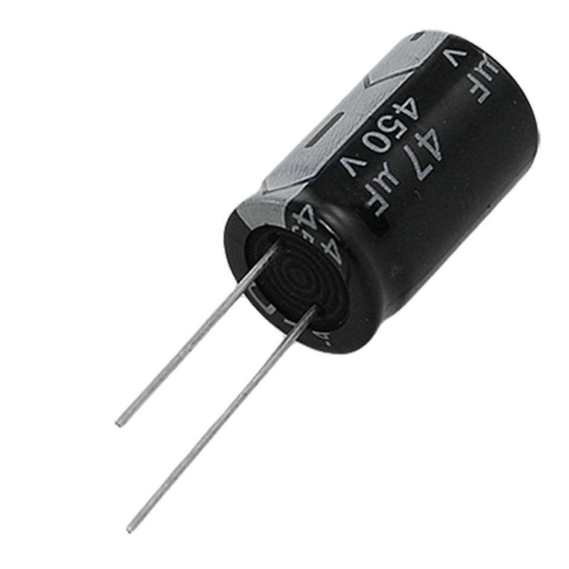
Capacitors
Notes:
Most students aged between 11 and 14 will not have experience of capacitors. It is worth explaining that they can be used to store energy, like a battery. Unlike a battery they can be charged very quickly (a few seconds; see the graph above for the shape) but generally can’t store as much energy. When discharging, that is, using the energy stored in the capacitor to do something (in this case, make a motor turn), the energy is supplied rapidly at first but the rate decreases with time. This will result in the vehicles moving rapidly at first but then moving more slowly as the charge on the capacitor reduces.
The amount of energy stored in a capacitor is related to the voltage across it and its capacitance. Capacitors with a very large capacitance are required for this to be a successful project (10 F).

Slide 7
Team Roles
Who will do which job?
Project Manager
Keep the team on track
Chief Designer
Lead on vehicle design.
Electrical Engineer
Design and construct powertrain
Construction Chief
Lead the vehicle build
Test Engineer
Test and analyse the build
Notes:
Ask students to assign team roles.

Slide 8
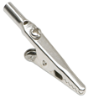
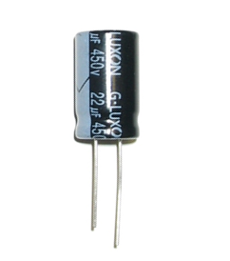

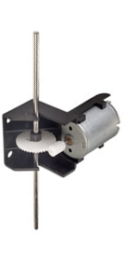
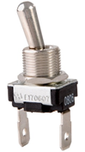
Circuit
Crocodile clips to battery
Capacitor
Aim
Your circuit must be designed so that you can:
Charge the capacitor without the motor using the energy
Flick a switch to transfer energy from capacitor to motor
[OPTIONAL] The switch must be your own design.
Connect wires using terminal blocks.
Terminal block
Motor
Switch
Notes:
This can be printed out for students. Teachers should discuss how the circuit operates with the “electrical engineers”. A demonstration is useful. They will act as experts in their team. To operate the circuit shown students should:
open the switch to disconnect the motor
Connect a 1.5 V battery to the capacitor ensuring the long leg of the capacitor is attached to the positive end of the battery. Leave the battery connected for about 10 seconds to fully charge the capacitor.
Remove the battery ensuring the loose wires do not touch and short circuit the capacitor causing it to discharge – this may cause heating in the wires. A voltmeter can be used to check that the capacitor is charged.
Close the switch to operate the motor.

Slide 9
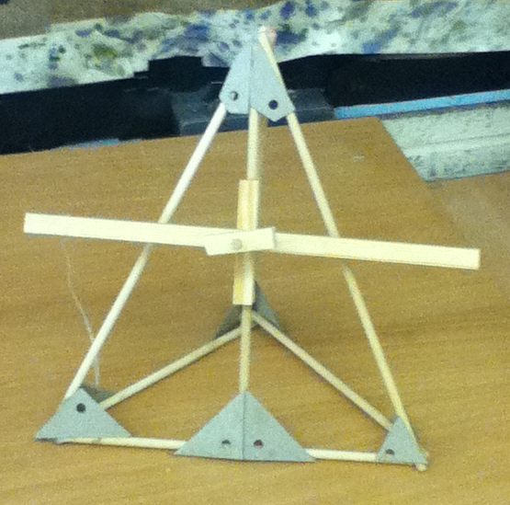
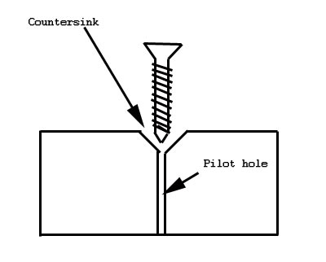
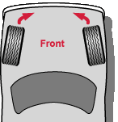
Construction Tips
Brace corners of timber by gluing card in position
Drill pilot holes before using any screws
Ensure that wheels are aligned correctly
Notes:
This can be printed out for students.
A key design concept is ensuring that vehicles have large wheels – this acts to gear up the worm motor allowing the cas to travel further and faster for each charge. A great deal of energy can be lost through friction i.e. poor construction.

